Slide 1

PRO New England
Roma Tile
Tools Down
Thursday, May 7, 2026
Crafting Creativity
As you come in, please grab a post it note and anonymously write down one thing about your job that frustrates you the most. Place that note on the wall.
Andy Aylesworth
Professor
Bentley University, Department of Marketing

Slide 2

Notes:
https://www.google.com/url?sa=i&rct=j&q=&esrc=s&source=images&cd=&cad=rja&uact=8&ved=2ahUKEwizuMbMmJ_eAhUQuFMKHUabD1IQjRx6BAgBEAU&url=https%3A%2F%2Fwww.gograph.com%2Fvector-clip-art%2Fpermission.html&psig=AOvVaw28WEXNT1W3wx4TKs0cyjT_&ust=1540474411978709

Slide 3


Slide 4


Slide 5
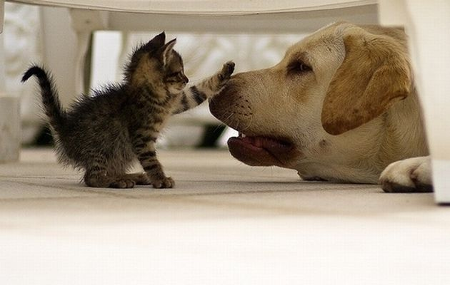

Slide 6

Key Takeaways
Diverge first, then converge
Connect the dots, and the more dots you have the better
Accept and build

